Slide 1

Data Analysis and Prediction on Insurance Dataset
Presented by: Priya Yadav

Slide 2
Introduction
Objective
Analyze the insurance dataset to identify key factors affecting insurance charges
Build predictive models to forecast insurance charges based on these factors
Dataset
File: insurance.csv
Contains 1338 entries with the following columns
age, sex, bmi, children, smoker, region, charges

Slide 3
Data Preprocessing
Converting Categorical Values to Numerical
Used LabelEncoder to convert categorical columns to numerical
sex: female = 0, male = 1
smoker: no = 0, yes = 1
region: northwest = 1, southeast = 2, southwest = 3, northeast = 0

Slide 4
Correlation Analysis
Heatmap
Visualized the correlation between features and target variable
Key findings
smoker has a strong positive correlation with charges
age and bmi also show positive correlations with charges
Weaker correlations observed for children, sex, and region

Slide 5
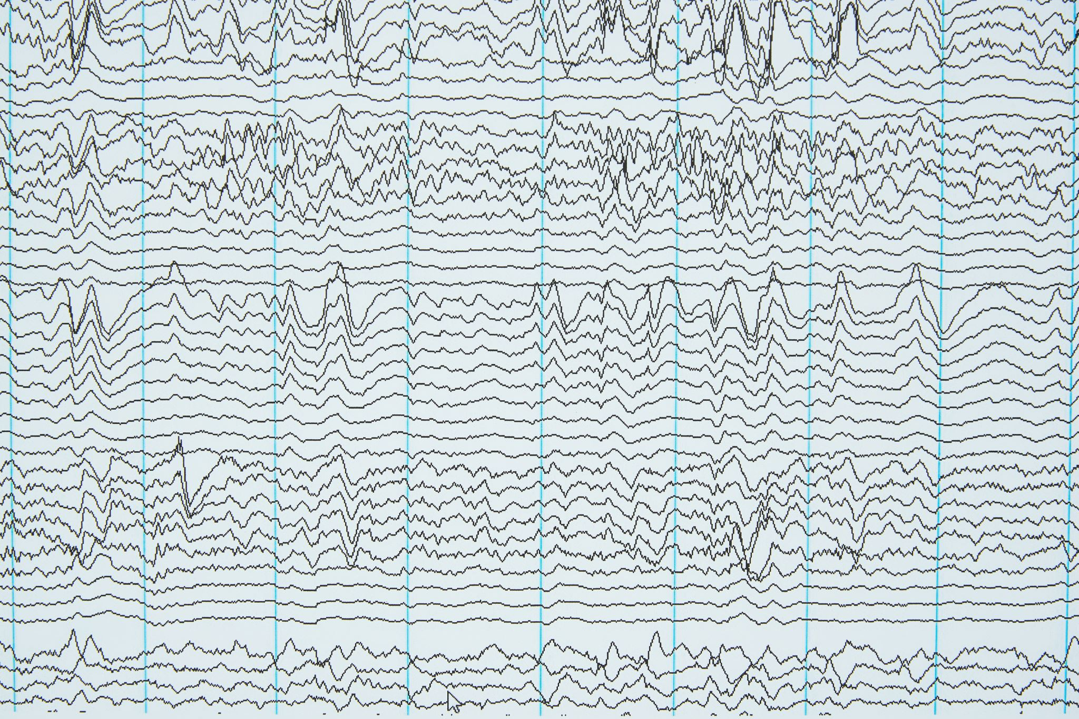
Data Visualization - Pair Plot
Pair Plot
Visualized relationships between all features
Diagonal plots show the distribution of each feature
Off-diagonal plots show relationships between pairs of features

Slide 6

Data Visualization - Skewness and Kurtosis
Skewness and Kurtosis
Calculated for each feature
age: Skewness = 0.055, Kurtosis = -1.245
sex: Skewness = -0.022, Kurtosis = -1.999
bmi: Skewness = 0.284, Kurtosis = -0.050
children: Skewness = 0.938, Kurtosis = 0.457
smoker: Skewness = 0.649, Kurtosis = -1.593
region: Skewness = -0.050, Kurtosis = -1.340
charges: Skewness = 1.515, Kurtosis = 1.606

Slide 7
Data Preperation
Splitting Data
Features : age, sex, bmi, children, smoker, region
Target : charges
Split into training and testing sets using train_test_split function with random_state

Slide 8

Model Training and Prediction - Linear Regression
Linear Regression
Trained on training data
Predicted on testing data
Performance Metrics
Mean Squared Error
R2 Score

Slide 9
Model Training and Prediction - Support Vector Regression
Support Vector Regression
Trained on training data
Predicted on testing data
Performance Metrics
Mean Squared Error
R2 Score

Slide 10
Model Training and Prediction - Ridge Regression
Ridge Regression
Trained on training data
Predicted on testing data
Performance Metrics
Mean Squared Error
R2 Score

Slide 11

Model Training and Prediction - Random Forest Regressor
Random Forest Regressor
Trained on training data
Predicted on testing data
Performance Metrics
Mean Squared Error
R2 Score

Slide 12
Hyperparameter Tuning - SVR
GridSearchCV for SVR
Parameter Grid: , 'gamma':
Best Parameters found
Performance Metrics after tuning
Mean Squared Error
R2 Score

Slide 13
Hyperparameter Tuning - Random Forest Regressor
GridSearchCV for Random Forest
Parameter Grid: , 'max_features': }
Best Parameters found
Performance Metrics after tuning
Mean Squared Error
R2 Score

Slide 14
Model Performance Comparison
Performance Metrics
Mean Squared Error and R2 Scores for all models
Bar Charts
MSE comparison across models
R2 Score comparison across models

Slide 15

Conclusion
Key Findings
Smoker status significantly impacts insurance charges
Random Forest Regressor performed best after hyperparameter tuning
Future Work
Explore additional features and more advanced models
Implement cross-validation for more robust evaluation

